Slide 1
Download this slide show and work on your own copy!

Slide 2
(Instructor notes - not included in presentation)
The model you made in this class is called a species distribution model (SDM).
Many studies are published with basically the same approach!
Look at this example paper: "Predicting current and future habitat of Indian pangolin (Manis crassicaudata) under climate change", Qasim et al., 2024.
It’ll probably look pretty familiar.
SDMs are used to guide official decisions about land management.
Look at this website by the New Zealand Dept. of Conservation: Predicting suitable breeding sites for New Zealand sea lions

Slide 3

(Guidelines for library work - not included in presentation)
Use the library website to look up references.
To reach the full search page, click in the search box & hit enter without typing anything
Then choose “UC Merced Catalog” from the dropdown menu and enter your search terms.
Suggested search strings: [your species name] + any of the following: “conservation”, “ecology”, “conservation biology”
Find and read at least one of each of the following kinds of resource:
one physical book from the collection (use the call number to find it in the stacks)
Call numbers will look like this:
one peer-reviewed journal article (look for the tag in the results)
Use these resources to fill in your knowledge about your species so you can tell us about your conclusions!
All the slides after this one are offered as a place to start preparing your presentation.

Slide 4
Interesting related websites (for if you’re done & bored)
Many public websites let you explore or add to data sets
Paleoclimate maps
https://www.ncei.noaa.gov/maps/paleo/
Land use changes
https://na.unep.net/atlas/googleEarth.php (instructions for finding the layer in Google Earth)
Visualizations of species occurrence databases
GBIF: https://www.gbif.org/species/
Neotoma: https://apps.neotomadb.org/explorer
Paleobiology Database: https://paleobiodb.org/navigator/
Participatory biodiversity science
iNaturalist: https://www.inaturalist.org/observations?place_id=any&subview=map
Download the iNaturalist app to contribute your own observations!

Slide 5
Other related resources for further study
Data science & programming resources for biodiversity and conservation:
“Geographic Data Science with R” book mentioned in class
https://bookdown.org/mcwimberly/gdswr-book/
ArcGIS is another commonly used language for this kind of work
Intro to GIS: https://storymaps.arcgis.com/collections/348fbd8b93304411ba8ad3641f192344
Besides habitat conservation and distribution modeling, there are many other uses for data science in conservation. For just a few examples:
Using computer vision with camera traps to ID wildlife
Using wildlife tracking software with tags to monitor movement patterns
Environmental quality management using monitoring devices (e.g. air quality)
Climate modeling, of course (someone had to make those models we used!)

Slide 6
Using the slide template
Save your presentation with a unique file name – ie,[your name]_[your species]
example: Blois_Microtus_pennsylvanicus.pptx
Replace [your study species] with the name of your chosen species
Update the text on each slide with information relevant to your chosen species
Before your presentation:
Make sure you delete any ‘extra’ text from the template that is not necessary for your species
Make sure you delete all the blue/gray background slides from the presentation

Slide 7
Introduction to [your study species]
Common name
Scientific name
Where is it found today?
Interesting/unique characteristics
Endangered/threatened?
Fossil record: how old is the species?
(check neotomadb.org and paleobiodb.org)
Other closely related species
picture

Slide 8
More ecological information about [your species]
Body size
Habitat
Diet
Lifespan
Reproductive behavior
Social behavior
etc
more pictures

Slide 9
Main conservation challenges to your species
Conservation challenge 1
Conservation challenge 2
etc…
[also name your sources here]

Slide 10
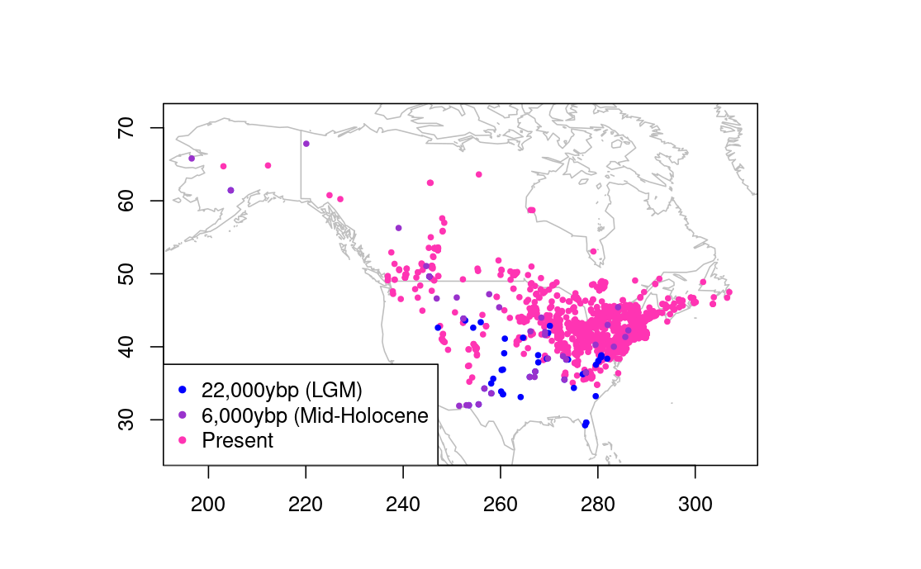
Occurrence data map (Pleistocene through modern)
How has your species’ observed range changed from the last ice age to the present?
(this image is from the tutorial with Microtus pennsylvanicus; delete it and use your own)

Slide 11
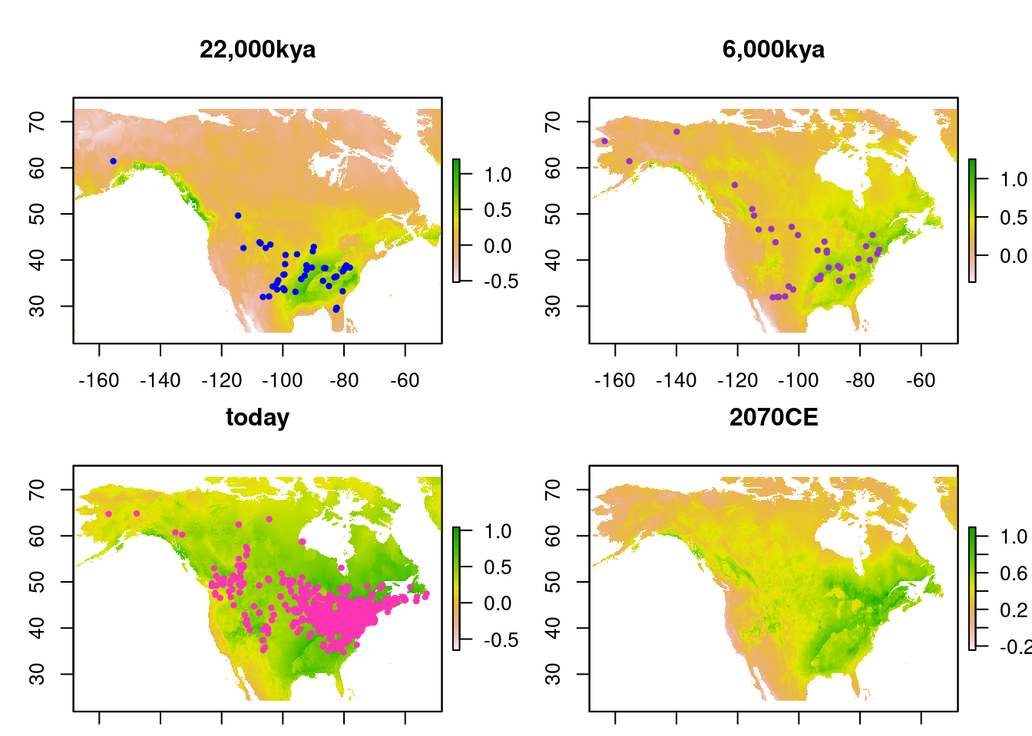
Species distribution maps (Pleistocene through Future)
How has the distribution of suitable habitat changed through the three past and present maps?
How will it change by 2070?
(this image is from the tutorial with Microtus pennsylvanicus; delete it and use your own)

Slide 12
Most important bioclimatic variables in the model
(from your species distribution model)

Slide 13
Conclusions about the species’ climate niche
(How do the bioclimatic variables in the model relate to what you read about your species’ ecological niche?)
(What other factors that weren’t in your model might be important to habitat suitability? Could they potentially be included?)

Slide 14
Conservation priorities
(Based on your species distribution models, which places on Earth are likely to be the most important to your species’ survival in the near future?)
(Based on your background research, what kind of condition do those places need to be kept in?)

